Slide 1
Unit 5
Software Testing
(From
Software Engineering, Roger Pressman,
5th Edition)

Slide 2
Software Testing – Why?
“ The development of software systems involves a series of production activities where opportunities for injection of human fallibilities are enormous. Errors may begin to occur at the very inception of the process where the objectives . . . may be erroneously or imperfectly specified, as well as [in] later design and development stages . . . Because of human inability to perform and communicate with perfection, software development is accompanied by a quality assurance activity. ”

Slide 3
What is Software Testing?
Software testing is a critical element of software quality assurance and represents the ultimate review of specification, design, and code generation.
Every time the program is executed, the customer tests it !
In order to find the highest possible number of errors (before deployment), tests must be conducted systematically and test cases must be designed using disciplined techniques.

Slide 4
Fundamentals
Software Testing is a destructive process. (At least psychologically !)
Beizer states :
  Myth - If we were really good at programming, there would be no bugs to catch.
  But there are bugs, then – are we bad at what we do?
  Is testing and test case design an admission of failure?
  Should we be guilty for not being telepathic?

Slide 5
Testing Objectives
Testing is a process of executing a program with the intent of finding an error.
A good test case is one that has a high probability of finding an as-yet undiscovered error.
A successful test is one that uncovers an as-yet-undiscovered error.
(A successful test is NOT the one in which no errors are found.)
“ Testing cannot show the absence of errors and defects, it can show only that software errors and defects are present. ”
It is important to keep this statement in mind as testing is being conducted.

Slide 6
Testing Principles
All tests should be traceable to customer requirements.
Tests should be planned long before testing begins.
The Pareto principle (80/20 rule) applies to software testing.
Testing should begin “in the small” and progress toward testing “in the large.”
Exhaustive testing is not possible.
  The number of path permutations for even a moderately sized program is exceptionally large. For this reason, it is impossible to execute every combination of paths during testing.
To be most effective, testing should be conducted by an independent third party.

Slide 7
Exhaustive Testing - Example
Consider a 100 line program in the language C.
After some basic data declaration, the program contains two nested loops that execute from 1 to 20 times each, depending on conditions specified at input.
Inside the interior loop, four if-then-else constructs are required.
There are approximately 10¹⁴ possible paths that may be executed in this program!
To put this number in perspective, we assume that a “magical” test processor has been developed for exhaustive testing.
The processor can develop a test case, execute it, and evaluate the results in one millisecond. Working 24 hours a day, 365 days a year, the processor would work for 3170 years to test the program.

Slide 8
Testability
How easily [a computer] program can be tested.
Characteristics
  Operability
  Observability
  Controllability
  Decomposability
  Simplicity
  Stability
  Understandability

Slide 9
Testability : Operability
“ The better it works, the more efficiently it can be tested. ”
The system has few bugs (bugs add analysis and reporting overhead to the test process).
No bugs block the execution of tests.
The product evolves in functional stages (allows simultaneous development and testing).

Slide 10
Testability : Observability
“ What you see is what you test. ”
Distinct output is generated for each input.
System states and variables are visible or queriable during execution.
Past system states and variables are visible or queriable (e.g., transaction logs).
All factors affecting the output are visible.
Incorrect output is easily identified.
Internal errors are automatically detected through self-testing mechanisms.
Internal errors are automatically reported.
Source code is accessible.

Slide 11
Testability : Controllability
“The better we can control the software, the more the testing can be automated and optimized.”
All possible outputs can be generated through some combination of input.
All code is executable through some combination of input.
Software and hardware states and variables can be controlled directly by the test engineer.
Input and output formats are consistent and structured.
Tests can be conveniently specified, automated, and reproduced.

Slide 12
Testability : Decomposability
“ By controlling the scope of testing, we can more quickly isolate problems and perform smarter retesting. ”
The software system is built from independent modules.
Software modules can be tested independently.

Slide 13
Testability : Simplicity
“ The less there is to test, the more quickly we can test it. ”
Functional simplicity : the feature set is the minimum necessary to meet requirements.
Structural simplicity : architecture is modularized to limit the propagation of faults.
Code simplicity : a coding standard is adopted for ease of inspection and maintenance.

Slide 14
Testability : Stability
“ The fewer the changes, the fewer the disruptions to testing. ”
Changes to the software are infrequent.
Changes to the software are controlled.
Changes to the software do not invalidate existing tests.
The software recovers well from failures.

Slide 15
Testability : Understandability
“ The more information we have, the smarter we will test. ”
The design is well understood.
Dependencies between internal, external, and shared components are well understood.
Changes to the design are communicated.
Technical documentation is instantly accessible.
Technical documentation is well organized.
Technical documentation is specific and detailed.
Technical documentation is accurate.

Slide 16
Test Case Design
Any engineered product can be tested in one of two ways:
  Knowing the specified function that a product has been designed to perform, tests can be conducted that demonstrate each function is fully operational while at the same time searching for errors in each function (black-box testing)
  Knowing the internal workings of a product, tests can be conducted to ensure that, internal operations are performed according to specifications and all internal components have been adequately exercised. (white-box testing)

Slide 17
Black-box Testing
Black-box tests are used to demonstrate that
  software functions are operational,
  input is properly accepted and output is correctly produced,
  integrity of external information (e.g., a database) is maintained.
A black-box test examines some fundamental aspect of a system with little regard for the internal logical structure of the software.

Slide 18
White-box Testing
Also called as glass-box testing
White-box testing of software is predicated on close examination of procedural detail.
Logical paths through the software are tested by providing test cases that exercise specific sets of conditions and/or loops.
The “status of the program” may be examined at various points to determine if the expected or asserted status corresponds to the actual status.

Slide 19
White-box Testing
As already illustrated “Exhaustive” test can’t be performed, however
  White-box testing should not be dismissed as impractical.
  A limited number of important logical paths can be selected and exercised.
  Important data structures can be probed for validity.

Slide 20
White-box Testing
Using white-box testing methods, the software engineer can derive test cases that
  Guarantee that all independent paths within a module have been exercised at least once
  Exercise all logical decisions on their true and false sides
  Execute all loops at their boundaries and within their operational bounds
  Exercise internal data structures to ensure their validity

Slide 21
White-box Testing : Why ?
Why don't we spend all of our energy (only) on black-box tests?
The answer lies in the nature of software defects
  Logic errors and incorrect assumptions are inversely proportional to the probability that a program path will be executed.
  We often believe that a logical path is not likely to be executed when, in fact, it may be executed on a regular basis.
  Typographical errors are random.
    for(j=0; j<n;i++)

Slide 22
Basis Path Testing
Basis path testing is a white-box testing technique.
The basis path method enables the test case designer to derive a logical complexity measure of a procedural design and use this measure as a guide for defining a basis set of execution paths.
Test cases derived to exercise the basis set are guaranteed to execute every statement in the program at least one time during testing.

Slide 23
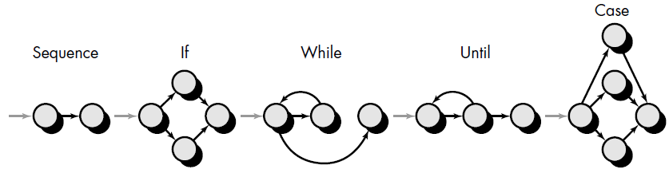
Flow Graph (or Program Graph) Notation
Each circle, called a flow graph node, represents one or more procedural statements.
A sequence of process boxes and a decision diamond can map into a single node.
The arrows on the flow graph, called edges or links, represent flow of control.
An edge must terminate at a node, even if the node does not represent any procedural statements
Areas bounded by edges and nodes are called regions. When counting regions, we include the area outside the graph as a region

Slide 24
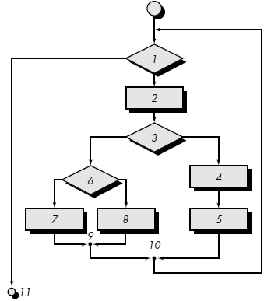
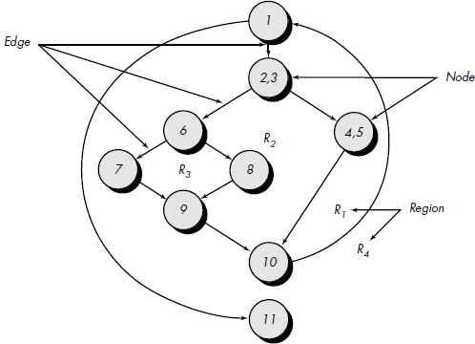
Mapping Flowchart into corresponding Flow Graph

Slide 25
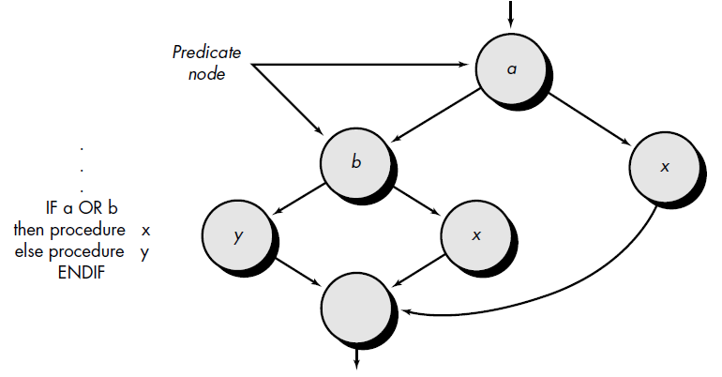
Handling Compound Conditions
A compound condition occurs when one or more Boolean operators (logical OR, AND, NAND, NOR) is present in a conditional statement.

Slide 26
Cyclomatic Complexity
Cyclomatic complexity is a software metric that provides a quantitative measure of the logical complexity of a program.
In the context of the basis path testing method, the value computed for cyclomatic complexity defines the number of independent paths in the basis set of a program and provides us with an upper bound for the number of tests that must be conducted to ensure that all statements have been executed at least once.
An independent path is any path through the program that introduces at least one new set of processing statements or a new condition.
An independent path must move along at least one edge that has not been traversed before the path is defined.

Slide 27
Computing Independent Paths
Path 1:
1-11
Path 2:
1-2-3-4-5-10-1-11
Path 3:
1-2-3-6-8-9-10-1-11
Path 4:
1-2-3-6-7-9-10-1-11
1-2-3-4-5-10-1-2-3-6-8-9-10-1-11 X (No New Edge)

Slide 28
Computing Basis Set
Paths 1, 2, 3, and 4 constitute a basis set for the flow graph in Figure.
That is, if tests can be designed to force execution of these paths (a basis set), every statement in the program will have been guaranteed to be executed at least one time and every condition will have been executed on its true and false sides.
Note that the basis set is not unique.
  In fact, a number of different basis sets can be derived for a given procedural design.

Slide 29
Computing Cyclomatic Complexity
How many paths to look for?
  Cyclomatic Complexity gives the answer.
It Can be computed in one of three ways :
  The number of regions of the flow graph correspond to the cyclomatic complexity.
  Cyclomatic complexity, V(G), for a flow graph, G, is defined as
    V(G) = E - N + 2
    where E is the number of flow graph edges, N is the number of flow graph nodes.
  Cyclomatic complexity, V(G), for a flow graph, G, is also defined as
    V(G) = P + 1
    where P is the number of predicate nodes contained in the flow graph G.

Slide 30
Computing Cyclomatic Complexity
The flow graph has four regions.
V(G)
  = 11 edges - 9 nodes + 2
  = 4.
V(G)
= 3 predicate nodes + 1 = 4.

Slide 31
Computing Cyclomatic Complexity
The flow graph has four regions.
V(G)
  = 11 edges - 9 nodes + 2
  = 4.
V(G)
= 3 predicate nodes + 1 = 4.

Slide 32
Deriving Test Cases
Using the design or code as a foundation, draw a corresponding flow graph.
Determine the cyclomatic complexity of the resultant flow graph.
Determine a basis set of linearly independent paths.
Prepare test cases that will force execution of each path in the basis set.

Slide 33
Control Structure Testing
Various Techniques :
  Basis Path Testing
  Condition Testing
  Data Flow Testing
  Loop Testing

Slide 34
Condition Testing
It focuses on testing each condition in the program.
A simple condition is a Boolean variable or a relational expression.
A relational expression takes the form
E1 <relational-operator> E2
Possible types of elements in a condition include
  a Boolean operator
  a Boolean variable
  a pair of Boolean parentheses
  a relational operator
  an arithmetic expression

Slide 35
Condition Testing Strategies
Branch testing
  For a compound condition C, the true and false branches of C and every simple condition in C need to be executed at least once.
Domain testing
  For a relational expression of the form
  E1 <relational-operator> E2
  Three tests are required to make the value of E1 greater than, equal to, or less than that of E2.
  If <relational-operator> is incorrect and E1 and E2 are correct, then these three tests guarantee the detection of the relational operator error.
  To detect errors in E1 and E2, a test that makes the value of E1 greater or less than that of E2 should make the difference between these two values as small as possible.

Slide 36
Control Structure Testing
Various Techniques :
  Basis Path Testing
  Condition Testing
  Data Flow Testing
  Loop Testing

Slide 37
Data Flow Testing
The data flow testing method selects test paths of a program according to the locations of definitions and uses of variables in the program.
Illustration
  Assume that each statement in a program is assigned a unique statement number and that each function does not modify its parameters or global variables.
For a statement with S as its statement number,
    DEF(S) = {X | statement S contains a definition of X}
    USE(S) = {X | statement S contains a use of X}

Slide 38
Data Flow Testing :DU Testing
The definition of variable X at statement S is said to be live at statement S' if there exists a path from statement S to statement S' that contains no other definition of X.
A definition-use or define-use (DU) chain of variable X is of the form [X, S, S'], where S and S' are statement numbers, X is in DEF(S) and USE(S'), and the definition of X in statement S is live at statement S'.
DU Testing Strategy : every DU chain be covered at least once.

Slide 39
Data Flow Testing
Data flow testing strategies are useful for selecting test paths of a program containing nested if and loop statements.
If statement S is an if or loop statement, its DEF set is empty and its USE set is based on the condition of statement S.
DU testing does not guarantee the coverage of all branches of a program.
  ( only in rare situations such as if-then-else constructs in which the then part has no definition of any variable and the else part does not exist. In this situation, the else branch of the if statement is not necessarily covered by DU testing.)

Slide 40
DU Testing Example : Definitions
Program Graph: (Or Flow Graph) Given a program (P) written in an imperative programming language, its program graph (G) is a directed graph in which nodes (N) are statement fragments, and edges (E) represent flow of control. In addition it details the definition, use and destruction of each variable.
DEF(v, n): node n in G(P) is a defining node of the variable v in V, iff the value of the variable v is defined at the statement fragment corresponding to node n.
USE(v, n): node n in G(P) is a usage node of the variable v in V, iff the value of the variable v is used at the statement fragment corresponding to node n

Slide 41
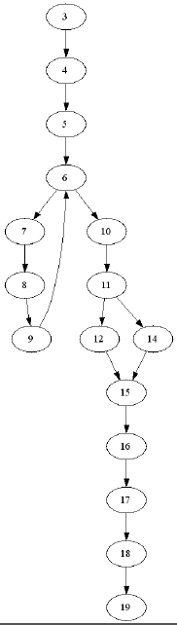
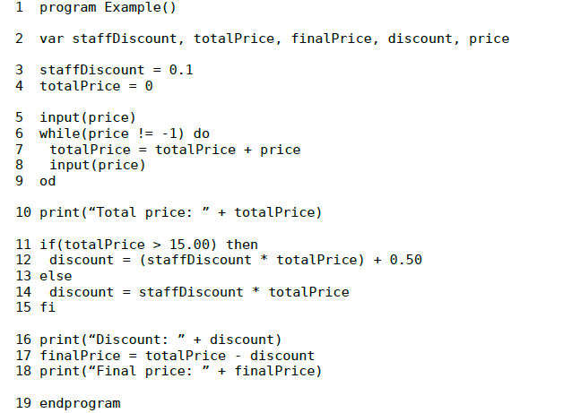
DU Testing Example
Program Graph

Slide 42
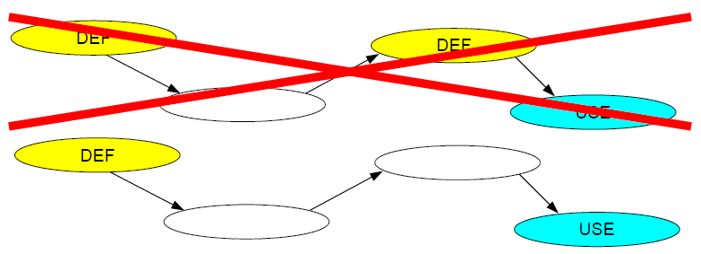
DU Path
Assume V is set of all variables and PATHS(P) is set of all paths for program P
For some v in V, if there exist DEF(v,m) and USE(v,n) then m and n should be initial and final nodes of the path respectively.

Slide 43
Control Structure Testing
Various Techniques :
  Basis Path Testing
  Condition Testing
  Data Flow Testing
  Loop Testing

Slide 44
Loop Testing
Loop testing is a white-box testing technique that focuses exclusively on the validity of loop constructs.
Four different classes of loops can be defined:
  Simple loops
  Concatenated loops
  Nested loops
  Unstructured loops

Slide 45
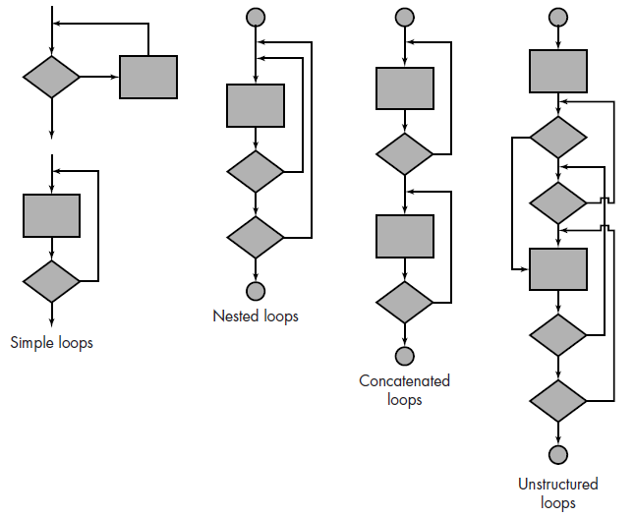
Loop Testing

Slide 46
Loop Testing : Simple Loops
The following set of tests can be applied to simple loops, where n is the maximum number of allowable passes through the loop.
  Skip the loop entirely.
  Only one pass through the loop.
  Two passes through the loop.
  m passes through the loop where m < n.
  n - 1, n, n + 1 passes through the loop.

Slide 47
Loop Testing : Nested loops
The number of possible tests would grow geometrically as the level of nesting increases.
Beizer suggests an approach to reduce the number of tests:
  Start at the innermost loop. Set all other loops to minimum values.
  Conduct simple loop tests for the innermost loop while holding the outer loops at their minimum iteration parameter (e.g., loop counter) values. Add other tests for out-of-range or excluded values.
  Work outward, conducting tests for the next loop, but keeping all other outer loops at minimum values and other nested loops to "typical" values.
  Continue until all loops have been tested.

Slide 48
Loop Testing : Concatenated loops
Concatenated loops can be tested similar to simple loops, if each of the loops is independent of the other.
However, if two loops are concatenated and the loop counter for loop 1 is used as the initial value for loop 2, then the loops are not independent, here the approach applied to nested loops is recommended.

Slide 49
Loop Testing : Unstructured loops
Whenever possible, this class of loops should be redesigned to reflect the use of the structured programming constructs.

Slide 50
End !

